Slide 1

Jira - Vikas

Slide 2

Bugs

Slide 3
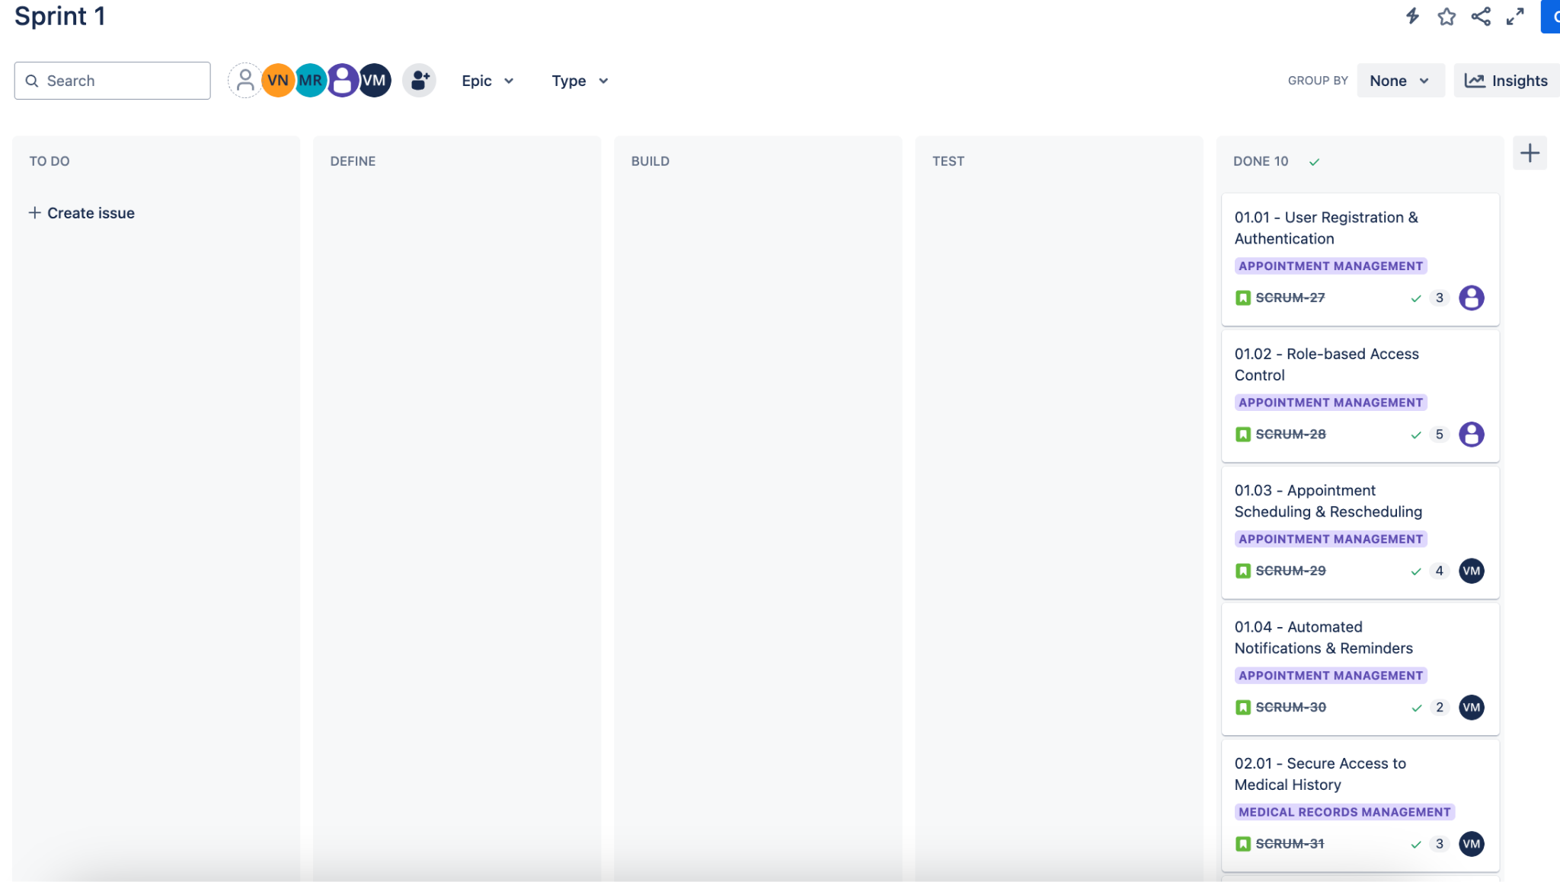
Kanban Board

Slide 4
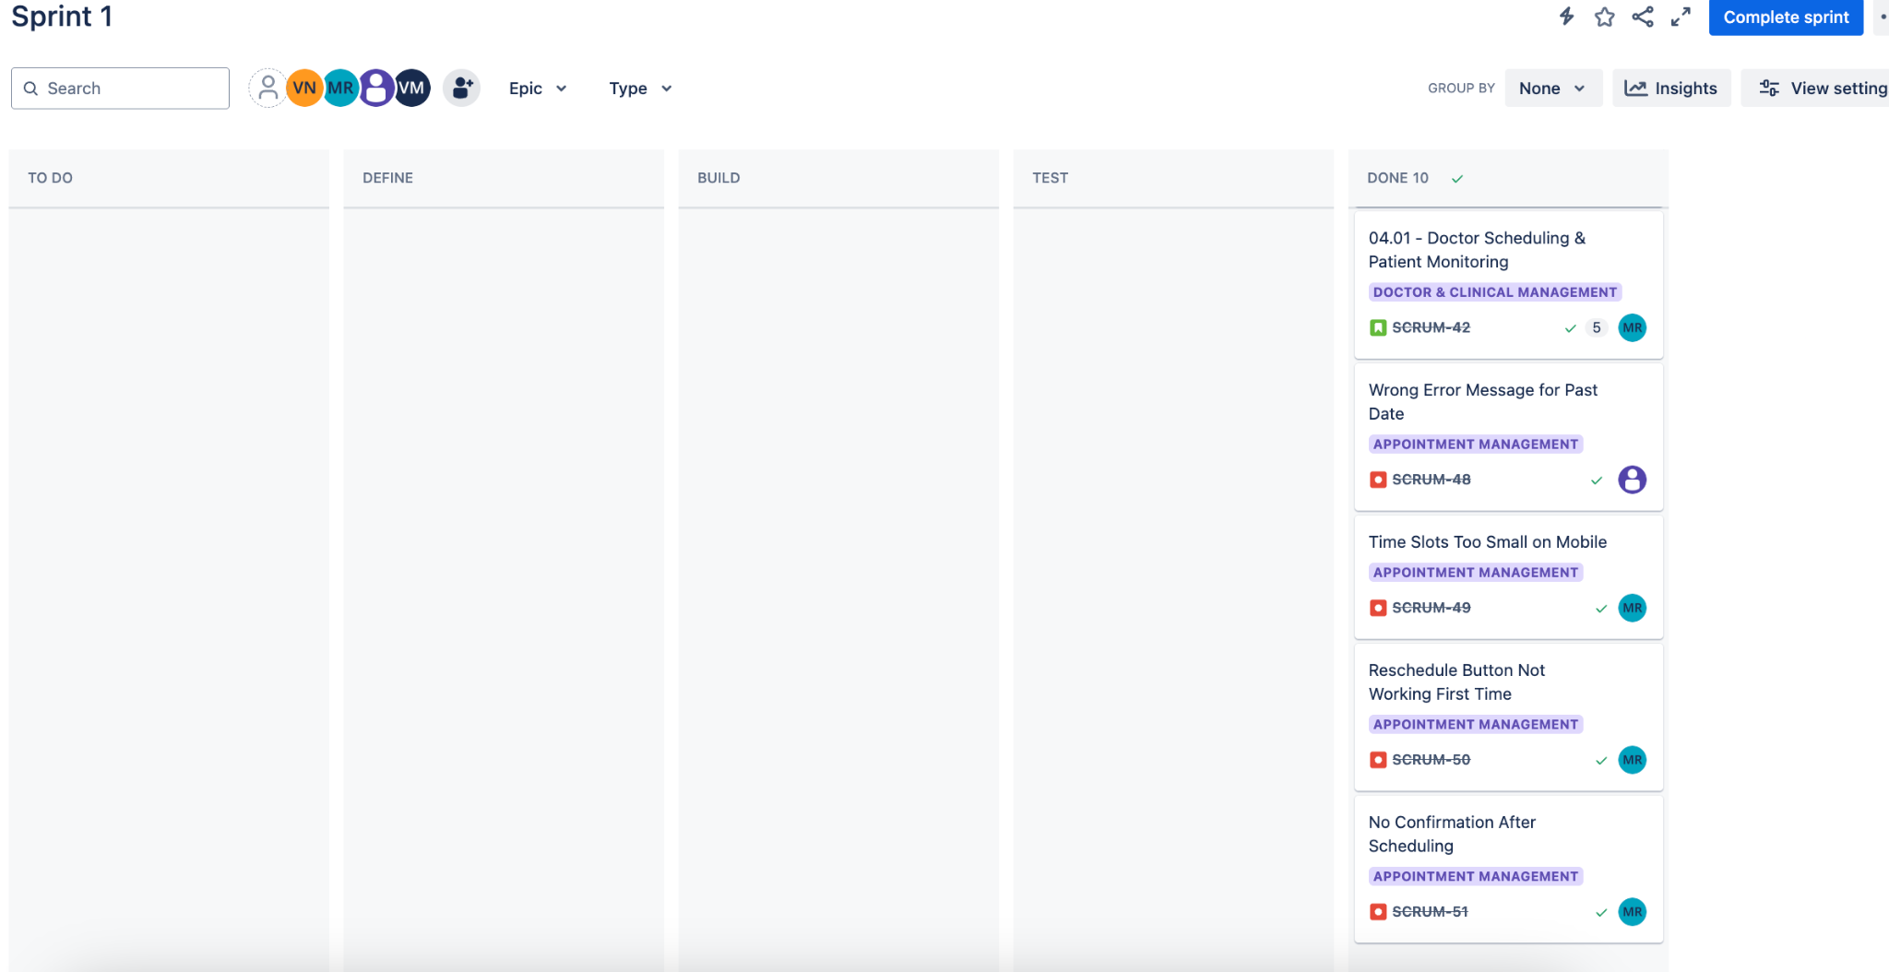
Kanban Board

